Slide 1

Bellman Equation
Notes:
1

Slide 2
Objectives
Derive the Bellman equation for state value functions
Define the Bellman equation for action value functions
Understand how Bellman equations relate current and future values.
Bellman Equation
2
Notes:
2

Slide 3
Bellman Equation
The Bellman equation is a fundamental concept in dynamic programming and reinforcement learning.
It expresses the relationship between the value of a state (or state-action pair) and the value of its successor states.
The Bellman equation plays a crucial role in many RL algorithms, as it provides a recursive definition for computing value functions.
3
Bellman Equation
Notes:
3

Slide 4
Bellman Equation Types
Bellman Expectation Equation:
The Bellman expectation equation expresses the relationship between the value of a state (or state-action pair) and the expected immediate reward plus the discounted value of the successor states.
For the state value function V π(s), it is defined as:
p(s′,r∣s,a) is the probability of transitioning to state s′and receiving reward r when taking action a in state s, and π(a∣s) is the policy's probability of selecting action a in state s. γ is the discount factor which determines the importance of future rewards.
4
Bellman Equation
Notes:
4

Slide 5
Bellman Equation Types
Bellman Expectation Equation:
The Bellman expectation equation expresses the relationship between the value of a state (or state-action pair) and the expected immediate reward plus the discounted value of the successor states.
For the action value function Qπ(s,a), it is defined as:
p(s′,r∣s,a) is the probability of transitioning to state s′and receiving reward r when taking action a in state s, and π(a∣s) is the policy's probability of selecting action a in state s. γ is the discount factor which determines the importance of future rewards.
5
Bellman Equation
Notes:
5

Slide 6
Bellman Equation Types
Bellman Optimality Equation:
The Bellman optimality equation expresses the optimal value of a state (or state-action pair) in terms of the maximum expected immediate reward plus the discounted value of the successor states.
For the state value function V∗(s), it is defined as:
V∗(s) represents the optimal value of state s under the optimal policy
6
Bellman Equation
Notes:
6

Slide 7
Bellman Equation Types
Bellman Optimality Equation:
The Bellman optimality equation expresses the optimal value of a state (or state-action pair) in terms of the maximum expected immediate reward plus the discounted value of the successor states.
For the action value function Q∗(s,a), it is defined as:
Q∗(s,a) represents the optimal value of taking action a in state s under the optimal policy.
7
Bellman Equation
Notes:
7

Slide 8
Bellman Equation
It define how the value functions relate to each other and to the dynamics of the environment.
RL algorithms leverage these equations to iteratively improve value function estimates and derive optimal policies.
Bellman equations to compute value functions.
8
Bellman Equation
Notes:
8

Slide 9
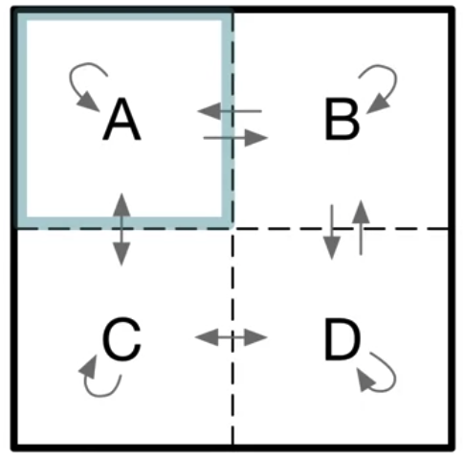
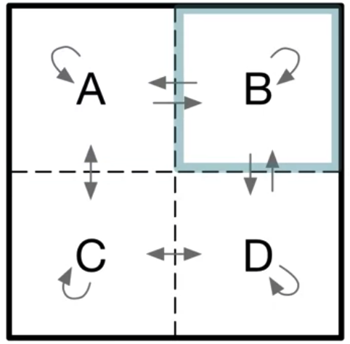
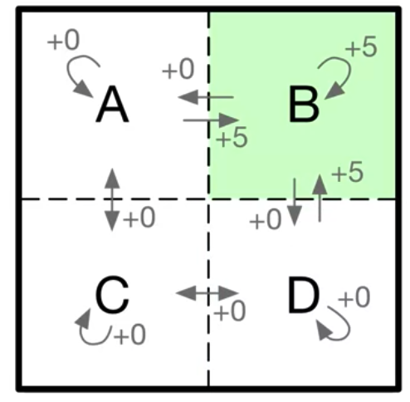
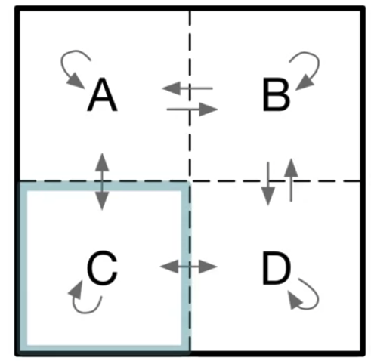
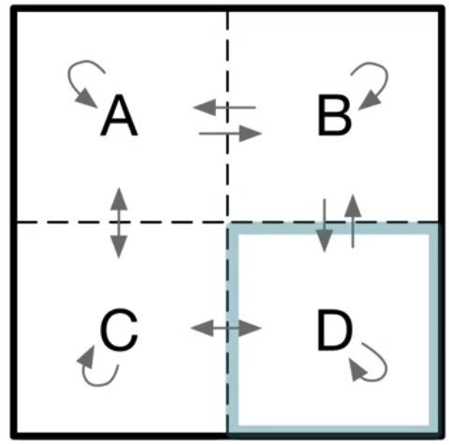
Bellman Equation
Example
Start from C → A→ B→ D. The reward is 0 everywhere except for any time the agent lands in state B.
9
Bellman Equation
Notes:
9

Slide 10
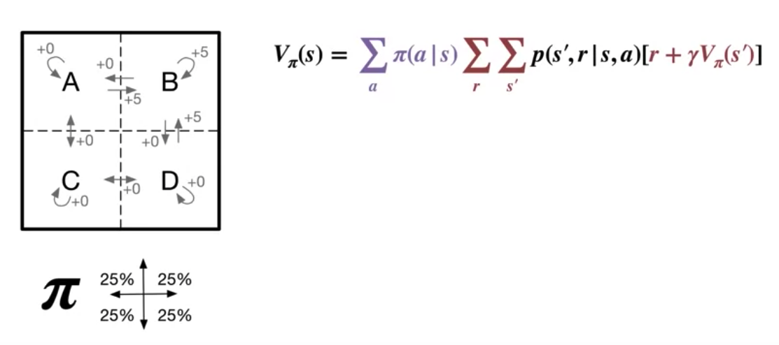
Bellman Equation
Example
Using the Bellman equation, we can write down an expression for the value of state A in terms of the sum of the four possible actions and the resulting possible successor states.
10
Bellman Equation
Notes:
10

Slide 11
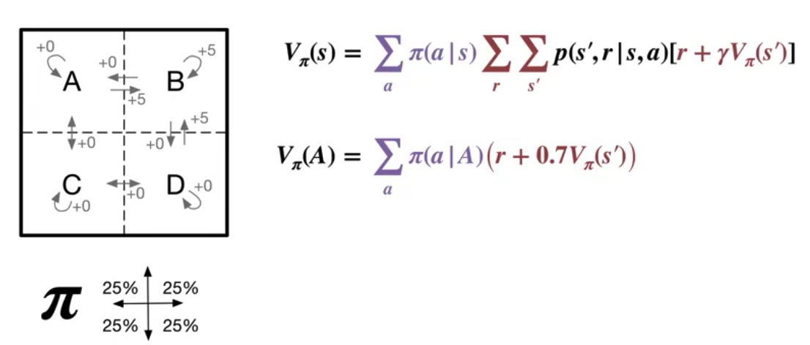
Bellman Equation
Example
The expression further in this case, because for each action there's only one possible associated next state and reward.
That's the sum over s prime and r reduces to a single value (s prime and r do still depend on the selected action, and the current state s) .
11
Bellman Equation
Notes:
11

Slide 12
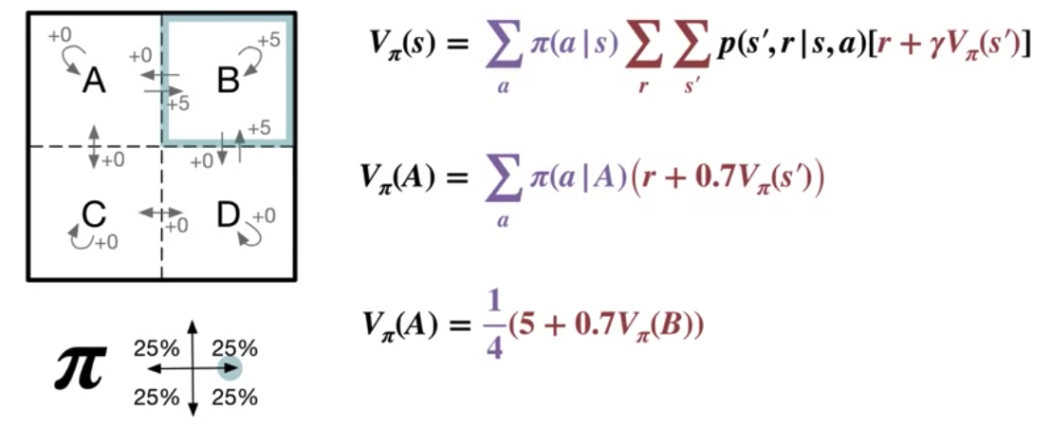
Bellman Equation
Example
If we go right from state A, we land in state B, and receive a reward of +5. This happens one quarter of the time under the random policy.
12
Bellman Equation
Notes:
12

Slide 13
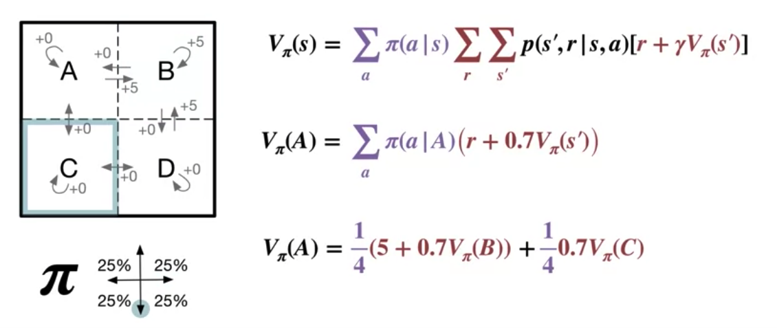
Bellman Equation
Example
If we go down, we land in state C, and receive no immediate reward. → this occurs one-quarter of the time
13
Bellman Equation
Notes:
13

Slide 14
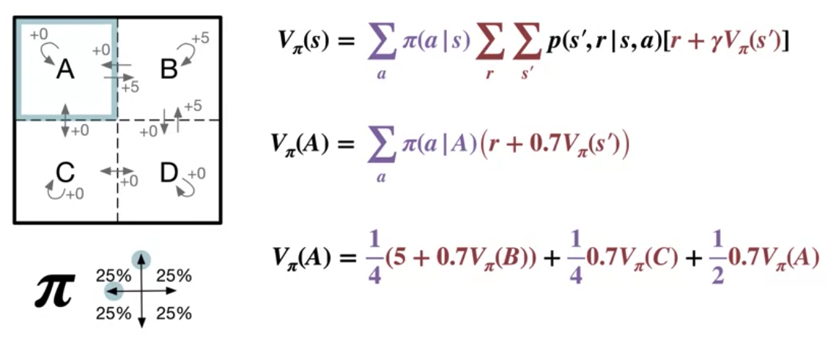
Bellman Equation
Example:
If you go either up or left, we will land back in state A again. Each of the actions, up and left, again, occur one-quarter of the time.
14
Bellman Equation
Notes:
14

Slide 15
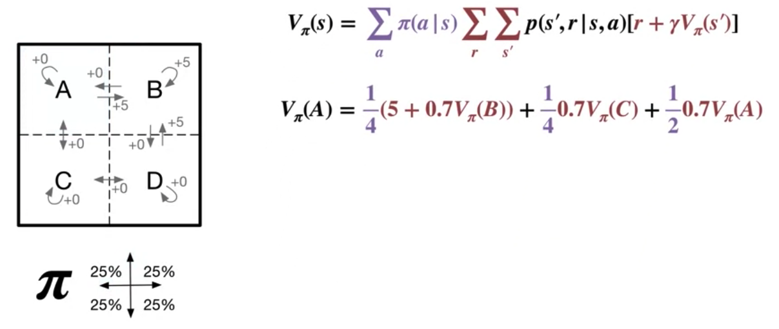
Bellman Equation
Example
Finally, we arrived at the expression shown here for the value of state A.
15
Bellman Equation
Notes:
15

Slide 16
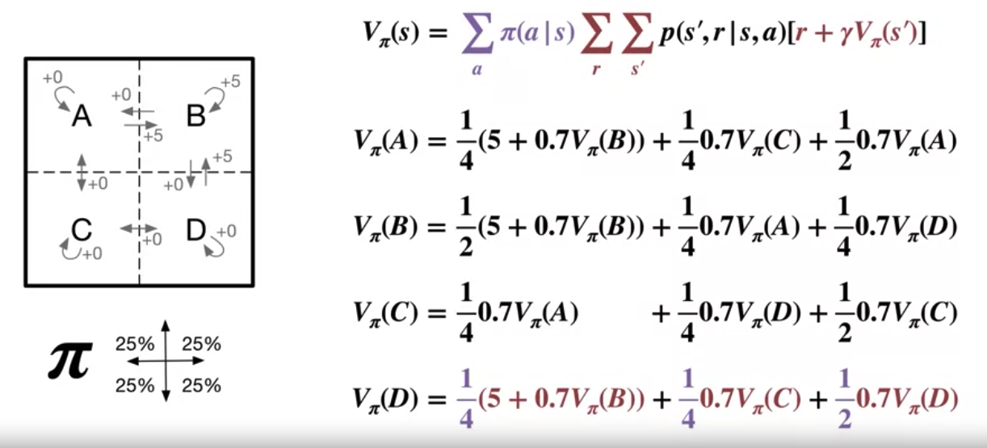
Bellman Equation
Example
Equation for each of the other states, B, C, and D.
16
Bellman Equation
Notes:
16

Slide 17
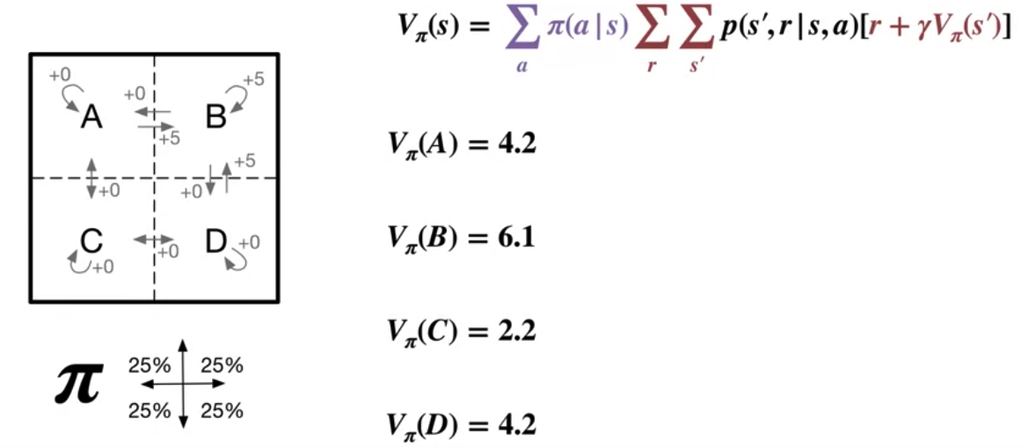
Bellman Equation
Example
The unique solution is shown here.
Bellman equation reduced an unmanageable infinite sum over possible futures, to a simple linear algebra problem.
17
Bellman Equation
Notes:
17

Slide 18
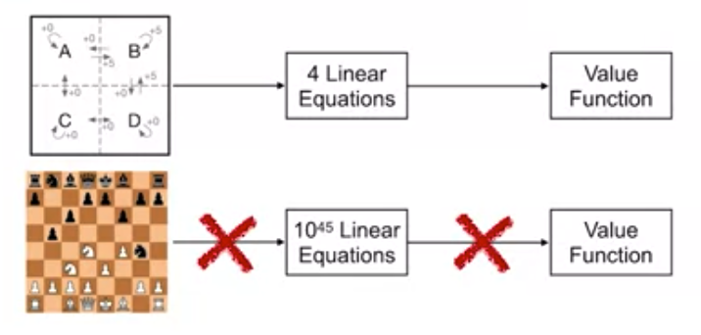
Bellman Equation
Bellman equations to compute value functions
The Bellman equation to directly write down a system of equations for the state values
More complex problems, this won't always be practical
18
Bellman Equation
Notes:
18

Slide 19
Summary
Derive the Bellman equation for state value functions
Define the Bellman equation for action value functions
Understand how Bellman equations relate current and future values.
Bellman Equation
19

Slide 20
Q & A
Bellman Equation
20

